Slide 1
AWS - CodePipeline

Slide 2
What is AWS Codepipeline?
AWS CodePipeline is a continuous delivery service you can use to model, visualize, and automate the steps required to release your software.
You can quickly model and configure the different stages of a software release process.
CodePipeline automates the steps required to release your software changes continuously.

Slide 3
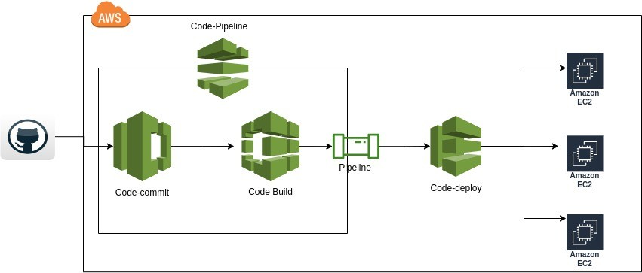
Architecture

Slide 4
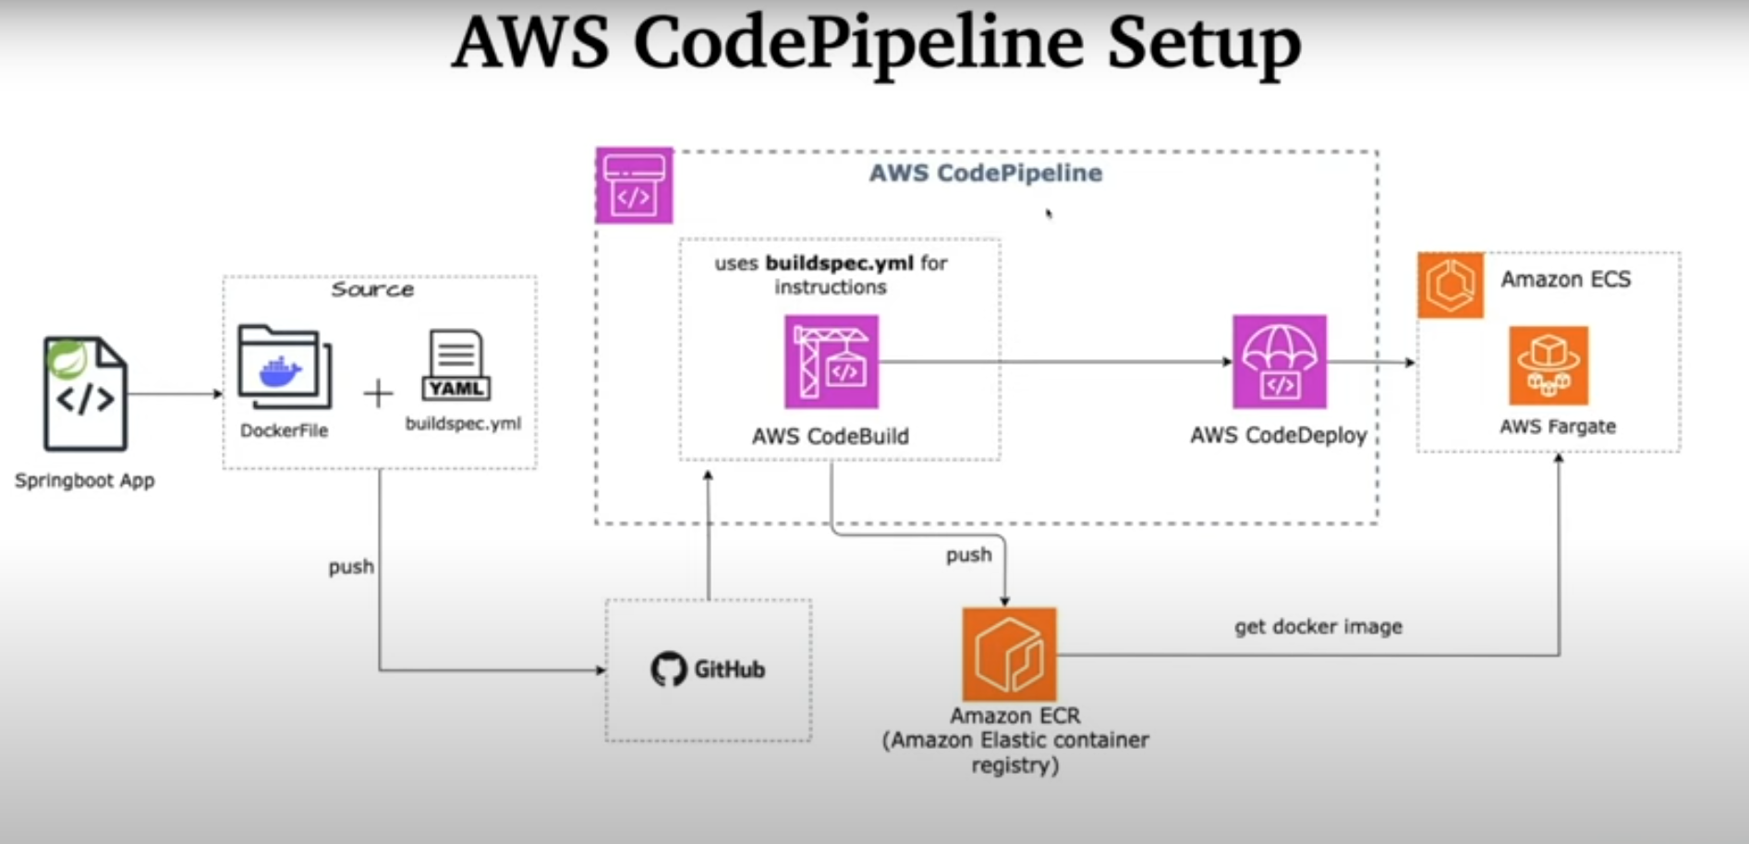
AWS CodePipeline Setup

Slide 5
Steps
Step 1 : Code Setup
Step 2 : Configure AWS CodeBuild
Step 3 : Configure AWS ECS - Cluster, service and task definition
Step 4 : Configure AWS CodePipeline

Slide 6
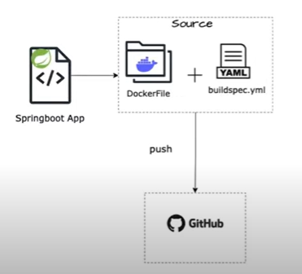
Step 1 : Code Setup
Create repository in Github
Create Microservice
Docker File
Push Code in GitHub

Slide 7
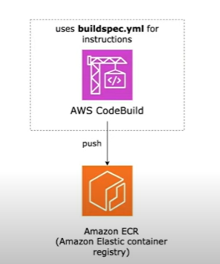
Step 2 : Configure AWS CodeBuild
Create Repository in ECR
Setup Source Provider
Create Service Role

Slide 8
Step 2 : Configure AWS CodeBuild
Create a private repository in ECR in the name spring-demo-ecr.
Create the buildspec.yml file in root of book project.
Here we are configuring CodeBuild to push the image into ECR repository.
In pre build step while login to docker copy the push notification.
Make sure to copy the uri of your ECR for the REPOSITORY_URI in the yml file
In post build we are pushing the image to the ECR.
Then we are specifying a container name and pushing that name into the imagedefinitions.json file
This imagedefinitions.json file will be used by AWS CodeDeploy service.
And now push the project once again in github

Slide 9
buildspec.yml file
version: 0.2
phases:
pre_build:
commands:
- echo Logging in to Amazon ECR....
- aws --version
#- $(aws ecr get-login --region ap-south-1 --no-include-email)
- aws ecr get-login-password --region ap-south-1 | docker login --username AWS --password-stdin YOUR_AWS_ACCOUNT_ID.dkr.ecr.ap-south-1.amazonaws.com
- # Replace with this to your repository URI
- REPOSITORY_URI=YOUR_AWS_ACCOUNT_ID.dkr.ecr.ap-south-1.amazonaws.com/spring-demo-ecr
- IMAGE_TAG=build-$(echo $CODEBUILD_BUILD_ID | awk -F":" '{print $2}')
build:
commands:
- echo Build started on `date`
- echo building the Jar file
- mvn clean install
- echo Building the Docker image...
- docker build -t $REPOSITORY_URI:latest .
- docker tag $REPOSITORY_URI:latest $REPOSITORY_URI:$IMAGE_TAG
post_build:
commands:
- echo Build completed on `date`
- echo pushing to repo
- docker push $REPOSITORY_URI:latest
- docker push $REPOSITORY_URI:$IMAGE_TAG
- echo Writing image definitions file...
# Give your container name
- DOCKER_CONTAINER_NAME=spring-demo-ecr
- printf '[{"name":"%s","imageUri":"%s"}]' $DOCKER_CONTAINER_NAME $REPOSITORY_URI:$IMAGE_TAG > imagedefinitions.json
- echo $DOCKER_CONTAINER_NAME
- echo printing imagedefinitions.json
- cat imagedefinitions.json
artifacts:
files:
- imagedefinitions.json
- target/springboot-aws-deploy.jar

Slide 10
Step 2 : Configure AWS CodeBuild - contd
Now go to aws console -> CodeBuild
Create a project and enter a name springboot-app-codebuild
Choose github as source.
Next choose Custom Source Credential -> Personal Access Token
Now generate a personal access token for your book github repository and provide it with a name in the space given.
For this go to github, settings->developer settings->personel access token->tokens->generate new token-> classic token.
Give a name for the token and give repo, write packages and delete packages permission and generate the token.
Next enter the github url of the book repository.
Next configure environment for managed image.
Check enhance GPU usage.
Under advanced setting check Priveleged->Enabled this flag
Next note the role name because we have to add some permissions to this role.
So go to iam and under role search for this tole and add 2 policies -> EC2ContainerRegistryFullAccess and EC@ContainerRegistryPowerUser
Under buildspec file choose specify a buildspec file.
Now upon successful build, we should see the newly pushed imahe in ECR.

Slide 11
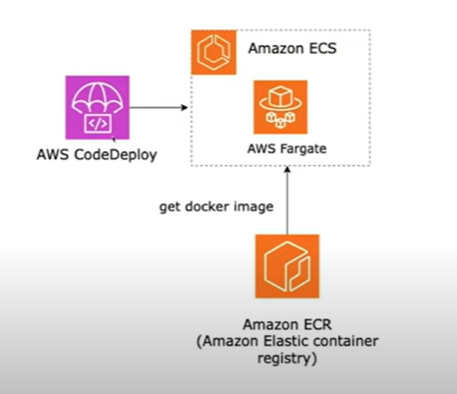
Step 3 : Configure AWS ECS - Cluster, service and task definition

Slide 12
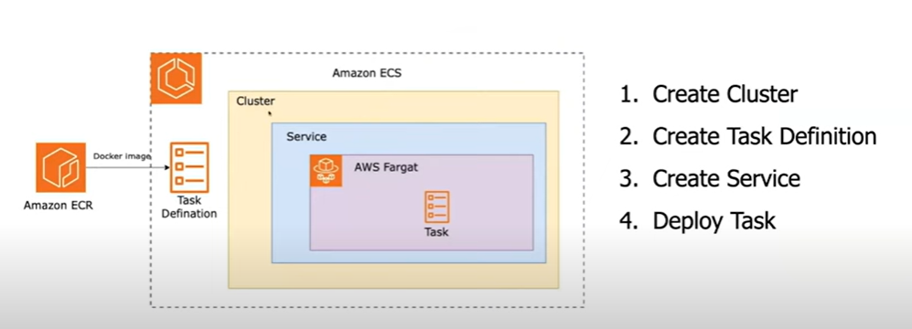
Step 3 : Configure AWS ECS - Cluster, service and task definition
We are going to do this first.

Slide 13
Step 4 : Configure AWS CodePipeline
Go to AWS CodePipeline.
Create a new code pipline.
Connect to github by choosing version2.
Create a new connection by installing the github app and choose the book repository.
Now specify the repository and branch in AWS. Click next.
For trigger choose no filter.
Choose other build provider and select the aws codebuild name that we created.
Then choose the project name and click on next.
For deploy provider choose AWS ECS and enter the cluster and service and click next.
Now create the pipeline for a success state.
Now make some changes in code and push the code to github.
Make sure that the container name in the buildspec.yml file and the container name in the task defn are the same.
You should see that the build in AWS CodePipeline will be automatically triggered.
Check ECR and see that a new image will be pushed in the repository.

Slide 14
Further reasearch
Add a new rest method and test.

Slide 15
END

